Slide 1


Assessment of the EMF Radiation Emissions from Electronic Devices and Areas around Telecom Towers
By
Adama Ruth Senam
Yaw Afriyie Cole
Supervisor: Dr. Margaret Richardson
Subject Area: Electrical and Computer Engineering
COMPUTER ENGINEERING DEPARTMENT
17TH NOVEMBER, 2023

Slide 2
OUTLINE
Introduction
Problem Statement
Relevance of Project
Objectives
Literature review
Research methodology
Project Timeline
Delegation of Tasks
Material Resources and Budget
Equipment Visualization
Expected Outcome and Conclusion

Slide 3
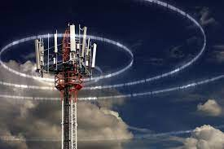
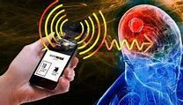
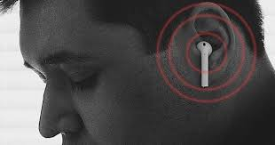

Slide 4
INTRODUCTION
In the modern world, we are surrounded by electronic devices and telecommunication towers that emit electromagnetic field (EMF) radiation.
In Ghana, the Ghana Standards Authority (GSA) has been tasked with investigating EMF radiations. However, due to the influx of electronic imports that often escape their reach at the ports, there are still significant gaps in our understanding of the effects of EMF radiation in the country.

Slide 5
INTRODUCTION Cont.
The EMF radiations can be classified into class A,B,C in accordance with international standards[1]. Our study seeks to assess their radiation emissions and determine whether it is within the permitted level.​

Slide 6
Problem statement
The increasing prevalence of electronic devices in everyday life raises concerns about electromagnetic radiation (EMR) emissions and their potential impact on human health.​
Medical sources suggest that the effects of EMF radiation are linked to chronic disease states, ADHD, Tinnitus, insomnia, Autism, Cancer, mental illnesses like depression, Alzheimer’s and Dementia, and problems related to focus, memory, and attentiveness [2]. ​

Slide 7
PROBLEM STATEMENT CONT.
Though the Ghana Standards Authority (GSA) is tasked with the regulation of electronic communication services in Ghana, the public still faces a significant challenge as there is a lack of independent data available on the radiation emissions of electronic devices.
This lack of data hinders the public's ability to make informed decisions regarding the use of electronic devices.

Slide 8
RELEVANCE OF PROJECT
RELEVANCE OF PROJECT
Information Gap Mitigation​
Enhanced Transparency​
Public Health Safeguarding​
Compliance with Standards​

Slide 9
objectives
To assess the EMR levels of both new and second-hand electronic devices.
To evaluate the EMR levels of areas surrounding cell sites/towers.
To publish the processed data of the EMR data.

Slide 10
Literature review
Author | Title | Focus | Limitations​
Tongning Wu, Ruiyun Peng, Lei Zhang, Kun Li | Human Exposure to New-Emerging Electric, Magnetic and Electromagnetic Fields^{[4]} | The health effects of EMF exposure, particularly neurological effects. It also advocates for the application of novel techniques, such as neuroviral tracers, neuroimaging, and neuro electrophysiology | The health effects records mentioned does not include data from Ghanaians
(emfrf.com) | EMF Testing, EMF Surveys and EMF Assessments^{[5]} | EMF Radiation Testing | Their database does not contain data from Ghana
Edwin Isotu Edeh | Electromagnetic Fields (EMFs) and Public Health[6] | An overview of EMFs, sources, and their potential health effects. It discusses the concerns raised about continuous exposure to EMF radiation from telecom towers | Their research does not cover EMR emissions in Ghana

Slide 11
Literature review
Author | Title | Focus | Limitations​
Marwah T. Ali, Yousif R. Muhsen, Raad Farhood Chisab, Sameeha N. Abed | Evaluation Study of Radio Frequency Radiation Effects from Cell Phone Towers on Human Health[7] | health impact of EMF radiation from cell phone towers and how it affects human immunity to diseases. It found that people living closer to the towers suffered more health problems than those living farther away. | the study was limited to a small city in Iraq, so its findings may not be generalizable to other locations i.e. Ghana.
Daniel T. DeBaun, Ryan DeBaun | Radiation Nation: Fallout of Modern Technology – Your Complete Guide to EMF Protection & Safety[8] | long and short-term effects of EMF exposure, especially on children | it does not cover all aspects of EMF radiation, particularly those related to telecom towers

Slide 12
Research methodology
Device/Tower Selection
EMF radiation Testing
Data Recording
Data Processing and Visualization
Analysis and Recommendation

Slide 13
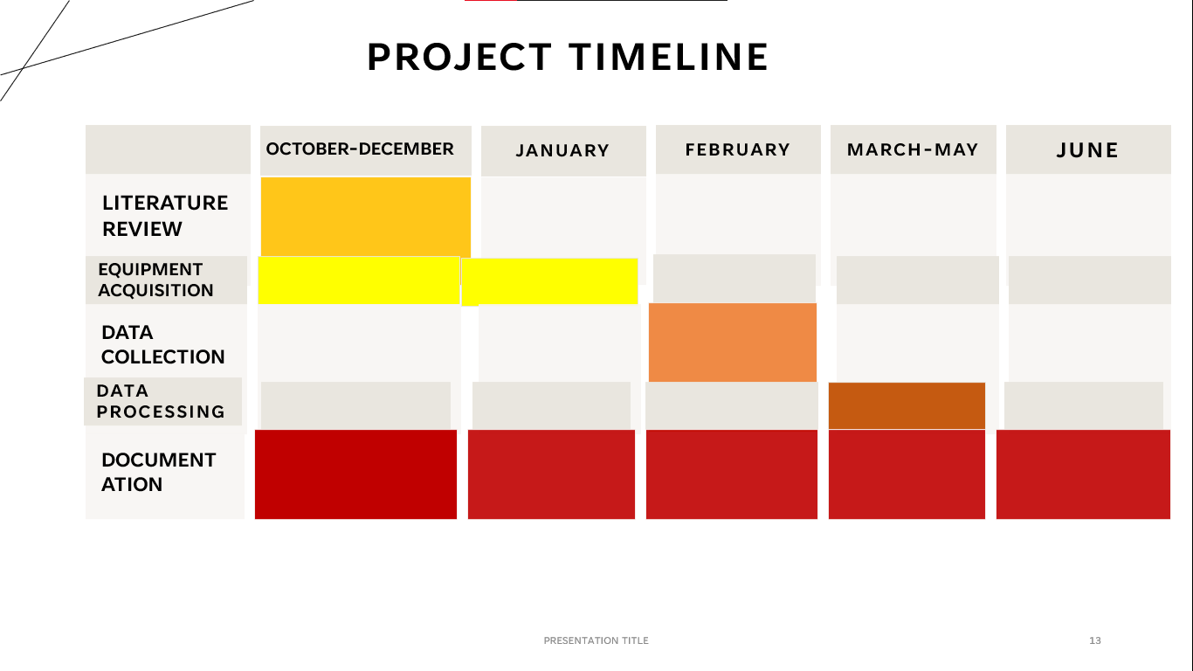
PROJECT TIMELINE
JANUARY
FEBRUARY
JUNE
MARCH-MAY
LITERATURE REVIEW
OCTOBER-DECEMBER
EQUIPMENT ACQUISITION
DATA COLLECTION
DATA PROCESSING
DOCUMENTATION

Slide 14
Delegation of tasks
Tasks | Ruth Senam Adama | Yaw Afriyie Cole
Literature Review
Device/Tower Selection
Data Preprocessing
Data Analysis and Visualization
Documentation

Slide 15
Materials resources Required
EMR testing equipment (spectrum analyzers, antennas, EMR Meter, Safety Gear etc.)
Computers and software (Tableau AI, data analysis tools)
Transportation and logistics
Miscellaneous expenses

Slide 16
EMF RADIATION TESTING Equipment
Miscellaneous electronic devices
Cell phones
Network Towers
Equipment required:
Log Periodic Antenna
Com-Power ACS-181
RESA Realtime EMC Spectrum Analyzer
EMR Meter
Equipment required:
ETS-Lindgren Model 5503 strip line-type electric field generator
RESA Realtime EMC Spectrum Analyzer
EMR Meter
Equipment required:
Horn Antenna
Com-Power ACS-181
Field Strength Meter

Slide 17

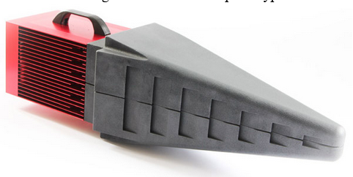

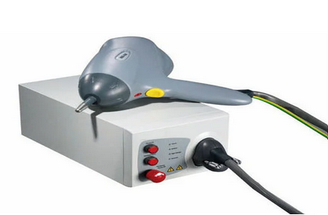
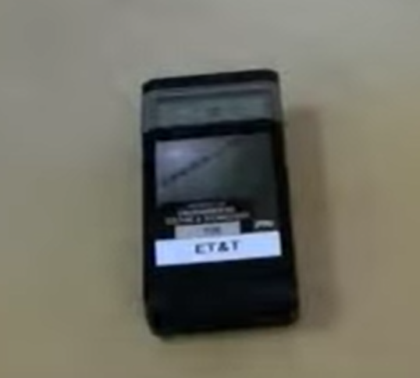

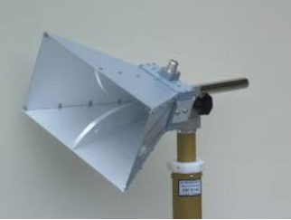
EMF radiation Testing Equipment
RESA Realtime EMC Spectrum Analyzer
ETS-Lindgren Model 5503 stripline-type electric field generator
COM-Power ACS 181 Power Amplifier
EMR meter
Log Period Antenna
Horn Antenna

Slide 18
Budget
MATERIAL RESOURCES | COST( GH₵.)
EMC testing equipment (spectrum analyzers, antennas, ESD generators, etc.) | 7800
Computers and software (Tableau AI, data analysis tools) | 0
Transportation and logistics | 500
Miscellaneous Expenses | 200
Total | 8500

Slide 19
Expected Outcome and Conclusion
Detailed assessment and comparison of electromagnetic radiation (EMR) levels emitted by new and second-hand electronic devices.
Thorough evaluation of EMR levels in the areas surrounding cell sites/towers.​
By the conclusion of this project, we expect to produce a clear and visually appealing representation of the EMR data, making it accessible for a wide audience.​

Slide 20
References
[1] Compliance Engineering: EMC Testing & RCM Certification in Melbourne (compeng.com.au)​
[2] https://www.betterhealth.vic.gov.au/health/healthyliving/electromagnetic-fields-emf-and-health-issues​
[3] https://www.gsa.gov.gh/testing/ ​
[4] https://www.testmyhome.com/emf-testing​
[5] EMF Testing, EMF Surveys and EMF Assessments By EMF & RF Solutions (emfrf.com) ​
[6] “Human Exposure to New-Emerging Electric, Magnetic and Electromagnetic Fields” - Authors: Tongning Wu, Ruiyun Peng, Lei Zhang, Kun Li1.https://www.itu.int/en/ITU-T/studygroups/2017-2020/20/sg20rgafr/20190827/Documents/s1-p1-edeh-EMF.pdf​
[7] “Electromagnetic Fields (EMFs) and Public Health” - Author: Edwin Isotu Edeh2.https://link.springer.com/article/10.3103/S0735272721030055​
[8] “Evaluation Study of Radio Frequency Radiation Effects from Cell Phone Towers on Human Health” - Authors: Marwah T. Ali, Yousif R. Muhsen, Raad Farhood Chisab, Sameeha N. Abed3. https://www.amazon.com/Radiation-Nation-Technology-Protection-Electromagnetic/dp/0998199605

Slide 21
THANK YOU

